Slide 1
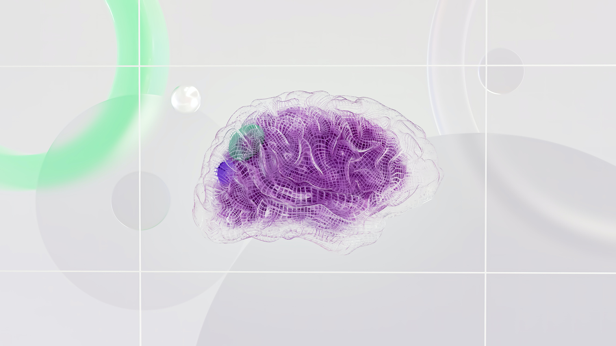

Brain tumor
detection
project

Slide 2





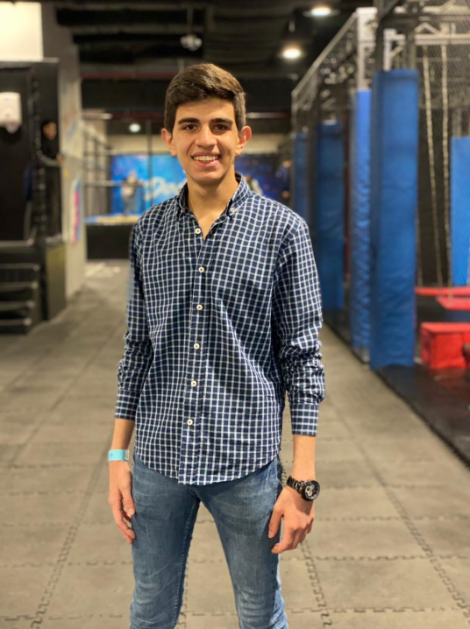

Our team Members
Supervisor :
DR.BASSM MOHAMED
Ziad Ashraf
Khaled Waleed
Ahmed badr
ENG : Fatma Saudi
Ahmed Farooq
Raghda Ragab
Yousef Azer
Karim Mohamed

Slide 3



01
introduction
03
Project Management
01
introduction
02
RELATED WORK
4
System Design
- Project Introduction
-Project Description
-Problem definition
-System Objectives
-System Features
-introduction
-The targeted users
-Functional requirement
-Non-Functional Requirements
-introduction
-Data set
-Summarization of Recent Works on Different Brain Tumor
4
- Project Introduction
-Project Description
-Problem definition
-System Objectives
-System Features
-introduction
-use case diagram
-Activity Diagram
-Sequence Diagram
-Class Diagram
content
3
2
1
1

Slide 4

1
introduction
03
Project Management
01
introduction
02
RELATED WORK
01
System Design
-introduction
-The targeted users
-Functional requirement
-Non-Functional Requirements
-Project Description
-Problem definition
-System Objectives
-System Features
-system components
4
-introduction
-Data set
-Summarization of Recent Works on Different Brain Tumor
- Project Introduction
-Project Description
-Problem definition
-System Objectives
-System Features
-introduction
-use case diagram
-Activity Diagram
-Sequence Diagram
-Class Diagram
content
3
2
1
1

Slide 5

01
introduction
03
Project Management
01
introduction
2
RELATED WORK
01
System Design
-introduction
-The targeted users
-Functional requirement
-Non-Functional Requirements
- Project Introduction
-Project Description
-Problem definition
-System Objectives
-System Features
4
-introduction
-Data set
-Summarization of Recent Works on Different Brain Tumor
- Project Introduction
-Project Description
-Problem definition
-System Objectives
-System Features
-introduction
-use case diagram
-Activity Diagram
-Sequence Diagram
-Class Diagram
Content
3
2
1
1

Slide 6

01
introduction
01
introduction
3
Project Management
02
RELATED WORK
01
System Design
- Project Introduction
-Project Description
-Problem definition
-System Objectives
-System Features
-introduction
-The targeted users
-Functional requirement
-Non-Functional Requirements
4
-introduction
-Data set
-Summarization of Recent Works on Different Brain Tumor
- Project Introduction
-Project Description
-Problem definition
-System Objectives
-System Features
-introduction
-use case diagram
-Activity Diagram
-Sequence Diagram
-Class Diagram
3
Content
2
1
1

Slide 7
4
System Design
01
introduction
03
Project Management
02
RELATED WORK
-introduction
-use case diagram
-Activity Diagram
-Sequence Diagram
-Class Diagram
Context Diagram
system analysis
Used Tools
Conclusions & Future Work
- Project Introduction
-Project Description
-Problem definition
-System Objectives
-System Features
-introduction
-The targeted users
-Functional requirement
-Non-Functional Requirements
4
-introduction
-Data set
-Summarization of Recent Works on Different Brain Tumor
3
Content
2
1
1

Slide 8
Introduction
In recent years, medical advancements have revolutionized the field of diagnostics, particularly in the detection and treatment of various diseases. One such area that has witnessed significant progress is the early detection and diagnosis of cancer. Timely identification of cancer plays a crucial role in improving patient outcomes and increasing the chances of successful treatment. This graduation project aims to develop a pioneering website that harnesses the power of artificial intelligence (AI) and medical imaging to predict the presence of cancer in individuals and determine its stage. The website will provide users with a user-friendly platform to upload their brain images, which will then be analyzed by advanced machine learning algorithms to generate accurate and reliable predictions.

Slide 9
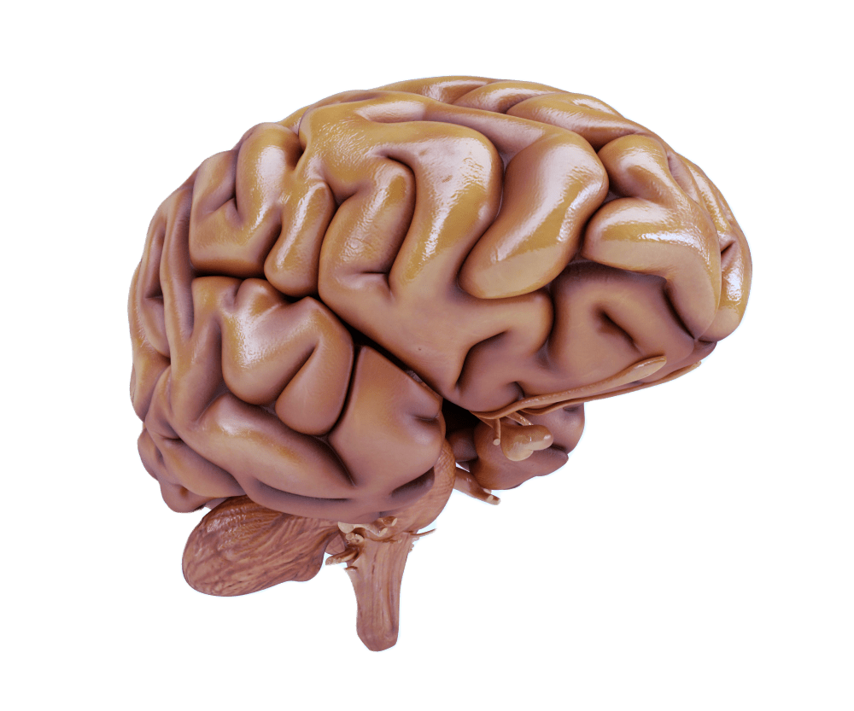
Project description
In light of the interest in the problem facing humanity, which is the dangerous disease of cancer, and in light of technological developments and scientific advances in the medical field and the field of computer science, we seek to combine them to present a project that can help people who want to ensure their safety from brain cancer
by solving some problems that they face during The process of diagnosis and help them choose the doctor and the appointment of the consultation in an easier way.

Slide 10
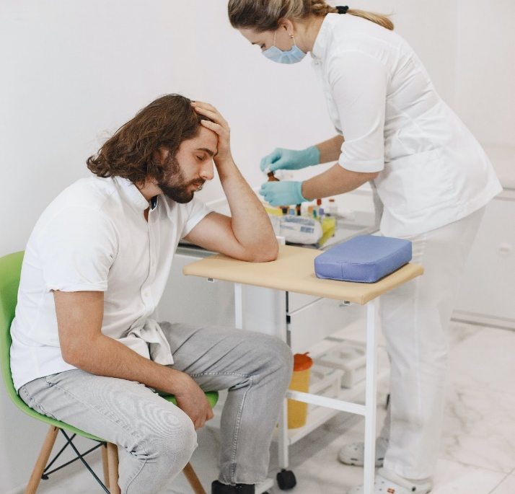


Problem definition
The traditional diagnostic process may be very stressful for the patient as well as for the physician involved in the diagnostic process, as the patient has to, we assume that
The patient waits a few minutes to perform the examinations that the doctor asked him to do
The patient is waiting for his appointment at the doctor for several minutes, up to an hour maybe.
The patient waits a few days to receive his tests from the examination center

Slide 11





System Objectives
The desired goal of our project is that we help the person who wants to know whether he has brain cancer or not more comfortably and respectfully of his time by the lowing:
1
2
3
4
5
helping him know the necessary tests in a faster way
Helping the patient to find the doctor who wants to consult him .
Reducing the waiting time for the patient at the doctor to find out the diagnosis
Assisting the doctor in managing his time, so the patient gets a better-quality consultation.
Making the patient check his health condition with higher efficiency

Slide 12






our Features
Information about the necessary tests for brain cancer.
Ability to upload images of examinations
Diagnosis of brain cancer
Choose a doctor for a consultation.
Choose the appropriate date for the consultation

Slide 13
System components
User Interface
Image Analysis Algorithms
Brain Tumor Detection
Image Upload Module
Prediction Engine

Slide 14
RELATED WORK

Slide 15
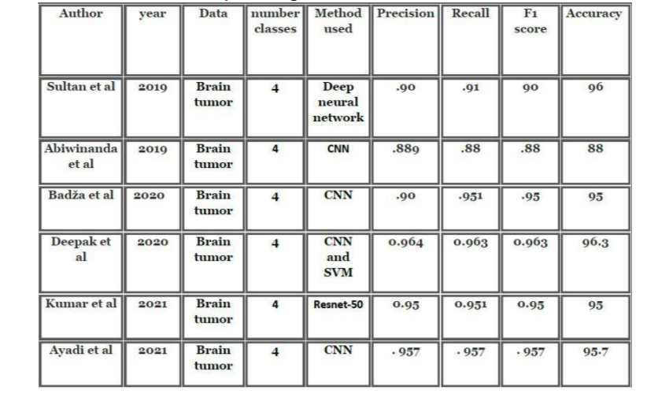
Summarization of Related Work
summarizes the presented exhaustive survey of state-of-the-art studies related to Brain tumors based on deep Learning

Slide 16
Data set
1-Dataset-1 : Brain tumor dataset containing a total of 5732 MRI images is available at the American Brain Tumor Association ( Brain Tumor Education website)
2-Dataset-2 containing a total of 5712 MRI images is available at Shenzhen University Association (Brain Tumor Education website)
Merging Dataset-1 and Dataset-2 would result in a new dataset with a total of 11450 MRI images .

Slide 17
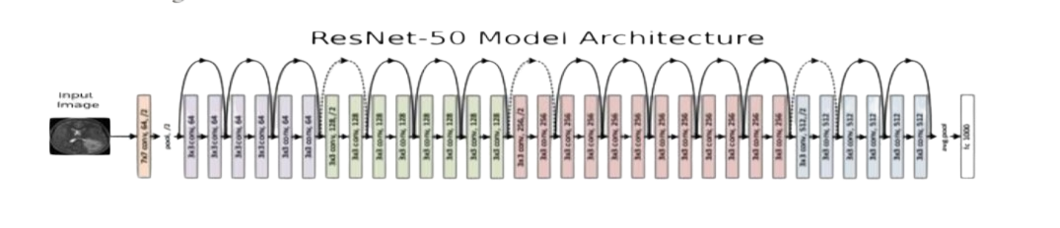
Our Model(RESNet-50)
The architecture consists of 48 convolutional layers, one MaxPool layer, and one average pool layer.

Slide 18
Why to use ResNet-50
ResNet-50 is a pre-trained CNN model that has been modified and used for feature extraction.
ResNet-50 is a popular variant of CNNs that address the vanishing gradient problem and achieve state-of-the-art performance by using Skip connections.
ResNet-50 that balances performance and computational efficiency .
ResNet was developed to address several pitfalls of deep neural networks.
resNet-50’s architecture enables it to handle complex image features effectively, making it a popular choice for various computer vision tasks.

Slide 19
The proposed model achieves a classification accuracy of up to 99.1% without increasing the data, and after increasing the data to 11450 by using other data, the model achieved a classification accuracy of up to 99.5%, outperforming the current models in terms of accuracy .
Accuracy Of our Model

Slide 20
Project Management

Slide 21
The targeted users
Experienced medical professionals who specialize in the interpretation of medical images, particularly those related to brain scans
Regulatory Authorities
Government agencies and regulatory bodies responsible for overseeing healthcare standards and practices
Medical Researchers
Neurologists
Medical Imaging Technicians
Professionals conducting research in the field of neurology and oncology
Medical doctors with expertise in the nervous system
Professionals responsible for operating imaging equipment and capturing the necessary scans
Software Administrators
Healthcare Administrators
Patients
IT professionals responsible for the maintenance, configuration, and security of the Brain Tumor Detection system
Individuals undergoing brain imaging for diagnostic purposes
Professionals involved in the management and administration of healthcare facilities

Slide 22
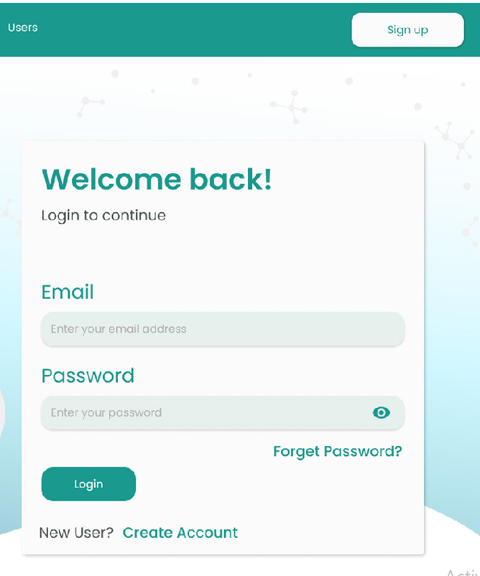
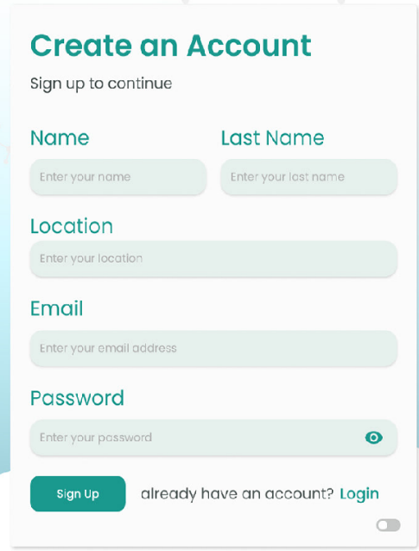
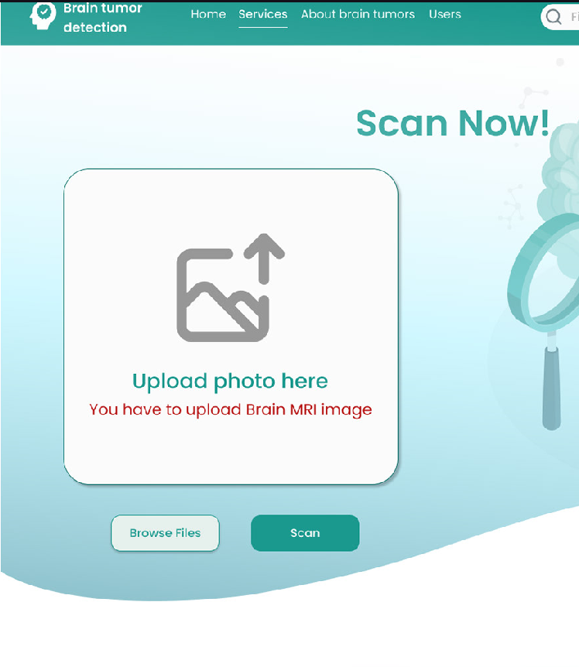


Functional requirement
login
Detect diseases
Patients can log in to the system.
Patient
The website provides the detection of brain diseases and Information to heal them..
Search for a doctor
The patient can search for the nearest doctor to him and book an appointment with him
Upload
MRI images The patient can upload MRI to the website to diagnose his condition.
Logout
The patient can log out from his account to log in with another account.
Sign up
The patient can register their data to the system
Book appointments

Slide 23
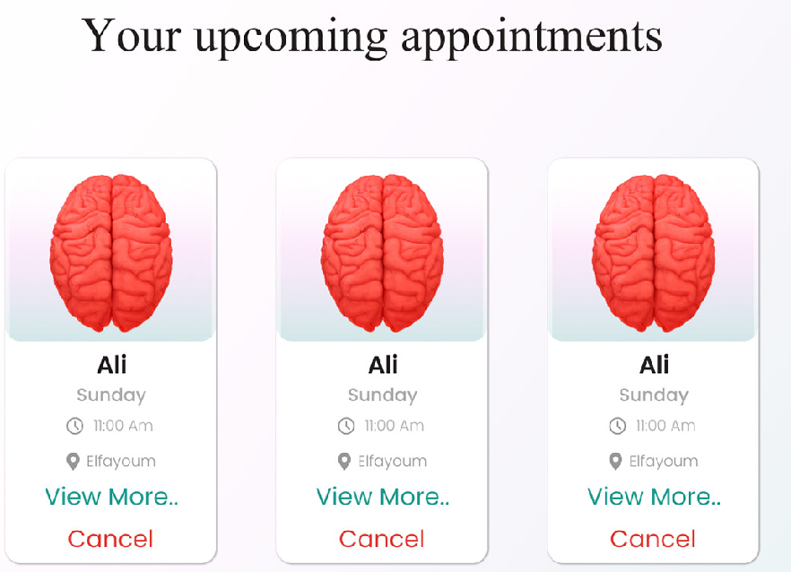
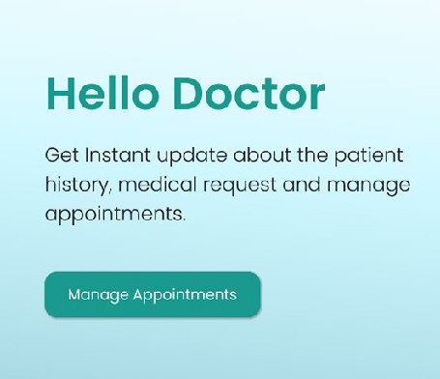
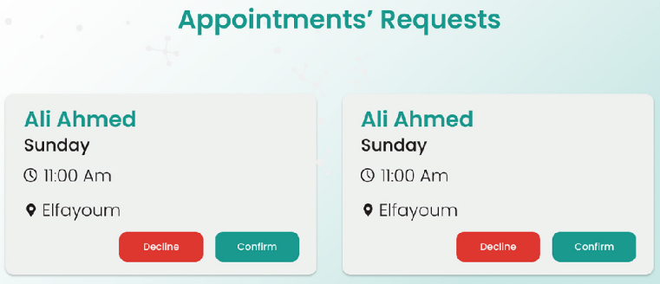
Functional requirement
login
Updating patient profile
Doctor
A doctor can log in to the website.
During the examination of the patient and knowledge of his medical history, the doctor
puts this data on the website to facilitate the re-examination again.
Signup
A doctor can register their data on the website.
Organizing appointments
with the doctor
The website knows the available appointments with the doctor to show them to the
Logout
A doctor can log out from his account to log in with another account..
Profile of the doctor
The website creates profiles for doctors available in the application.
The website provides articles about brain tumor information and advice for the best care
of our health.
Provide articles and advice to take care of our health.

Slide 24
Non-Functional Requirements
High performance
Security
Reliability
Usability
Maintainability
Scalability

Slide 25
System Design

Slide 26
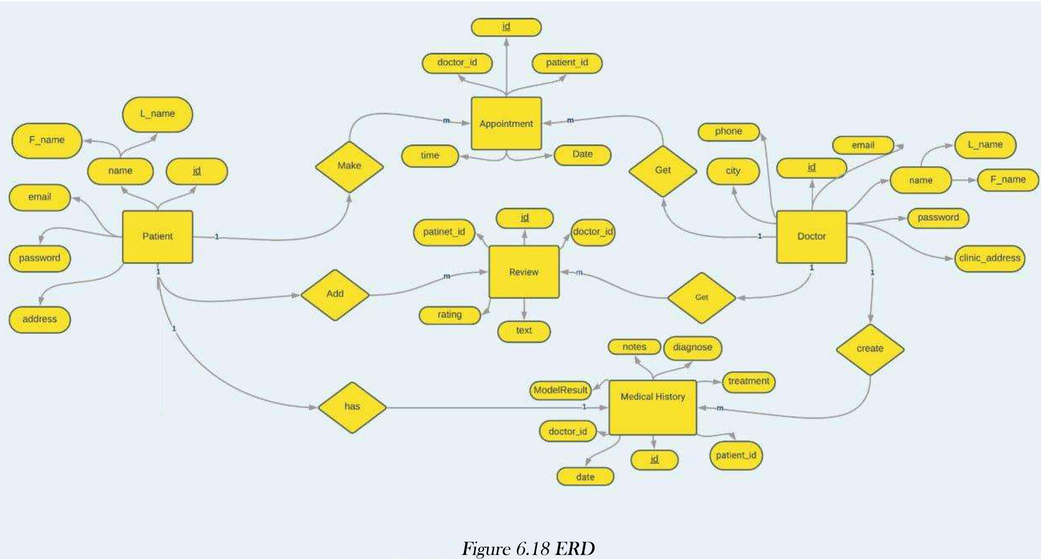
Data Modeling
An entity-relationship model (ERM) is an abstract and conceptual representation of data. Entity
relationship modeling is a database modeling method, used to produce a type of conceptual
schema or semantic data model of a system, often a relational database, and its requirements
in a top-down fashion.

Slide 27
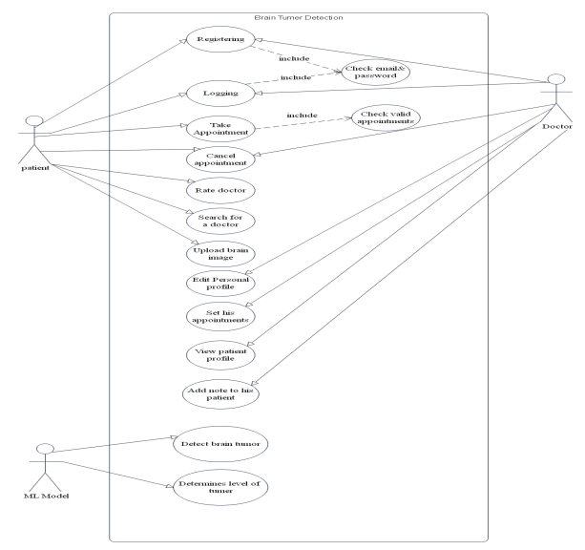
Use Case Diagram
Use cases represent system functionality from the user’s perspective
Use Case diagrams to describe who will use the system and in what ways the user expects to
interact
with the system Use Case diagrams represent the interactions between use cases and
actors.
Use Case diagram represents the interactions between systems, external systems, and
Use Case diagram represents the interactions between systems, external syystems, and users.
Look Figure 4.4 Patient, doctor, and ML model use case diagram
Pdf document

Slide 28
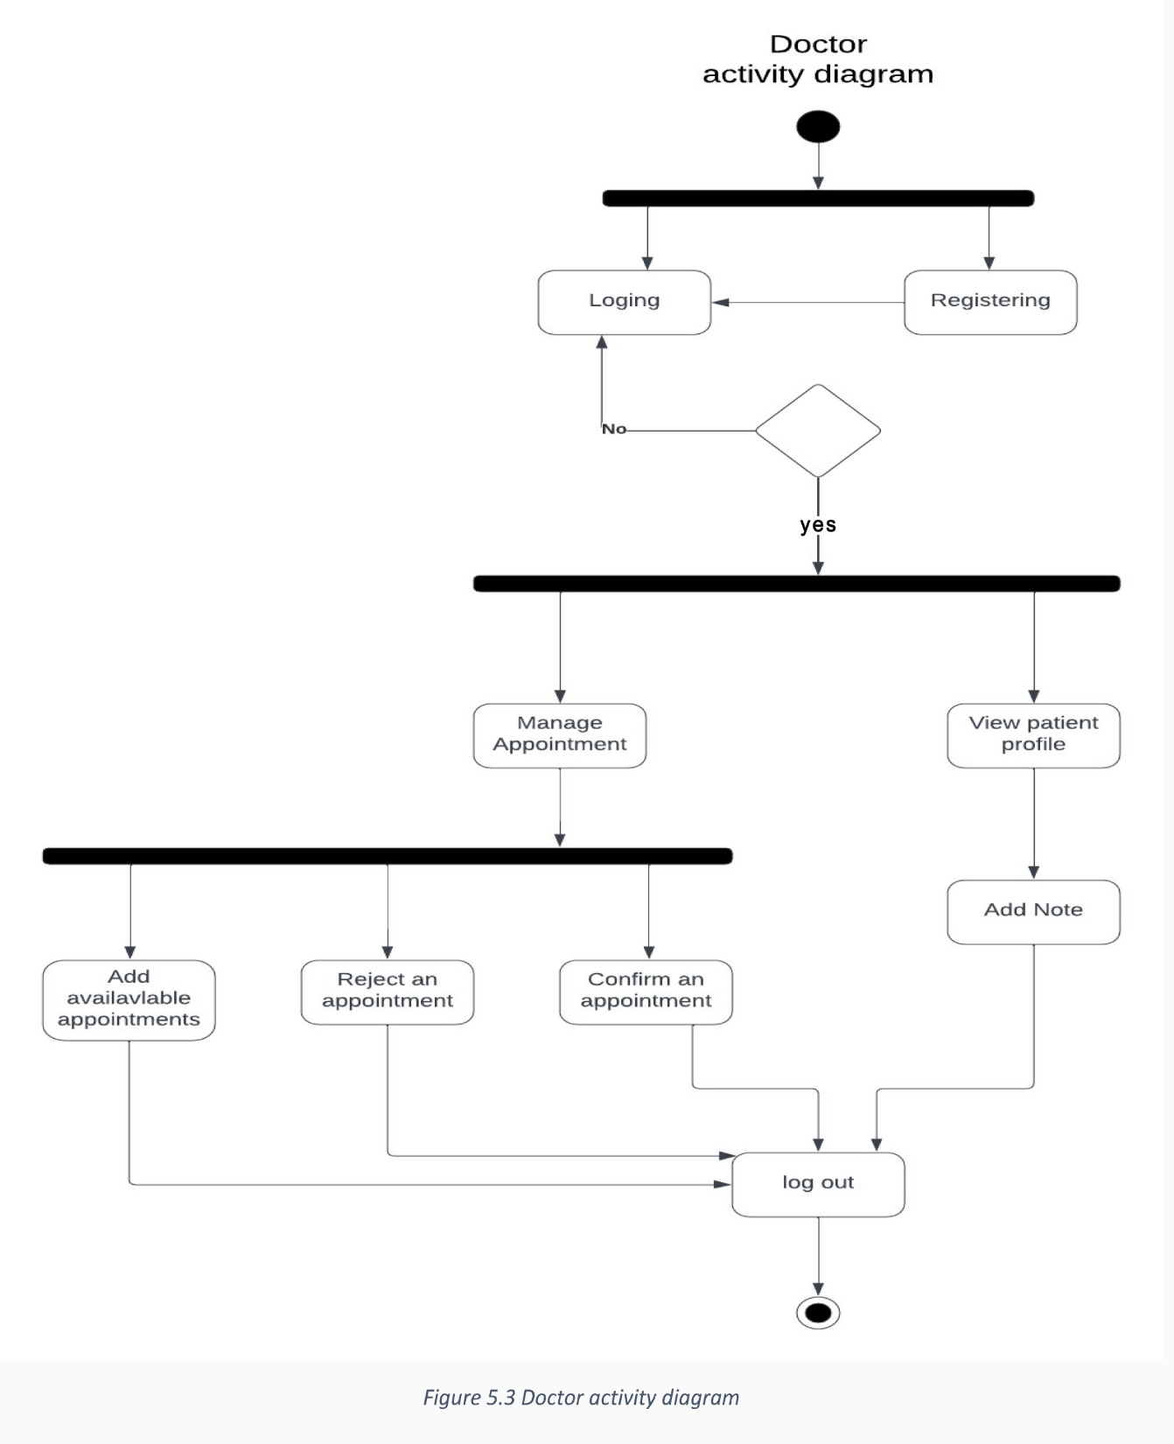
Activity Diagram
Doctor
An Activity Diagram is used to describe the sequential flow of activities of a use case (flow of
functionality) in a system.

Slide 29
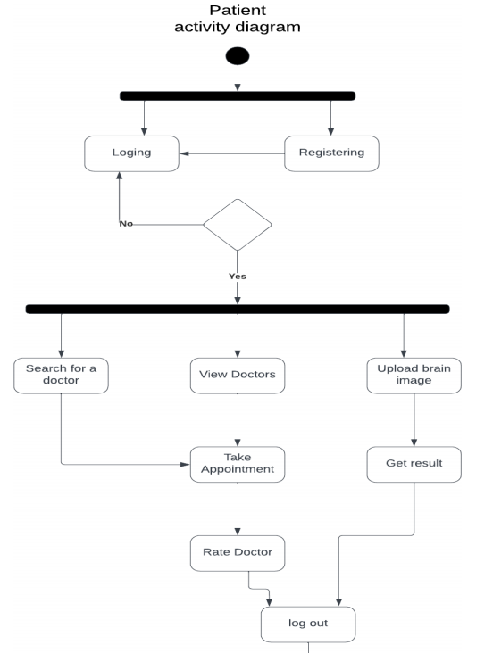
Activity Diagram
Patient
An Activity Diagram is used to describe the sequential flow of activities of a usecase (flow of
functionality) in a system.
LookFigure : Patient activity diagram

Slide 30
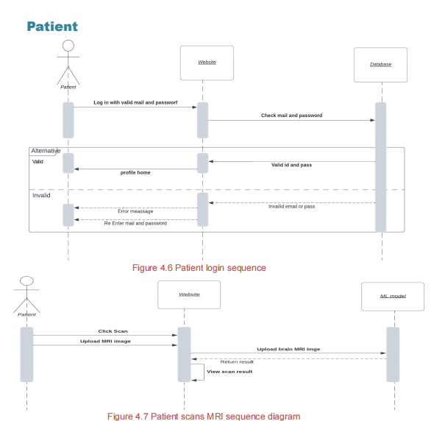
Sequence Diagram
Patient
A sequence diagram shows object interactions arranged in a time
sequence. It depicts the objects and classes involved in the scenario
and the sequence of messages exchanged between the objects needed
to carry out the functionality of the scenario

Slide 31
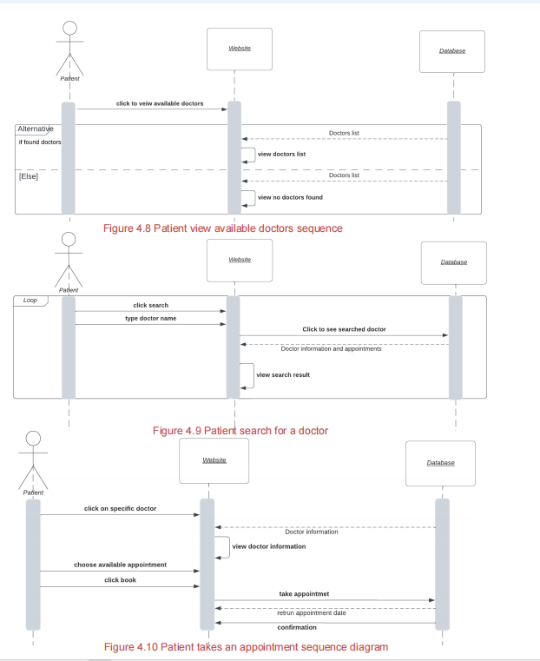
Sequence Diagram

Slide 32
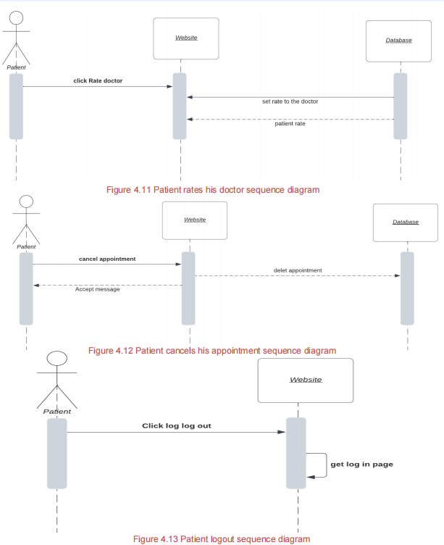
Sequence Diagram

Slide 33
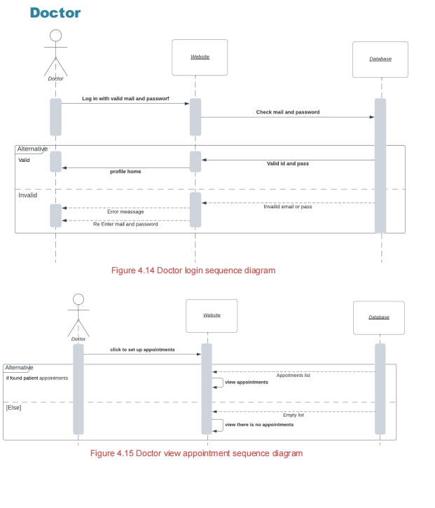
Sequence Diagram
Doctor
A sequence diagram shows object interactions arranged in a time
sequence. It depicts the objects and classes involved in the scenario
and the sequence of messages exchanged between the objects needed
to carry out the functionality of the scenario

Slide 34
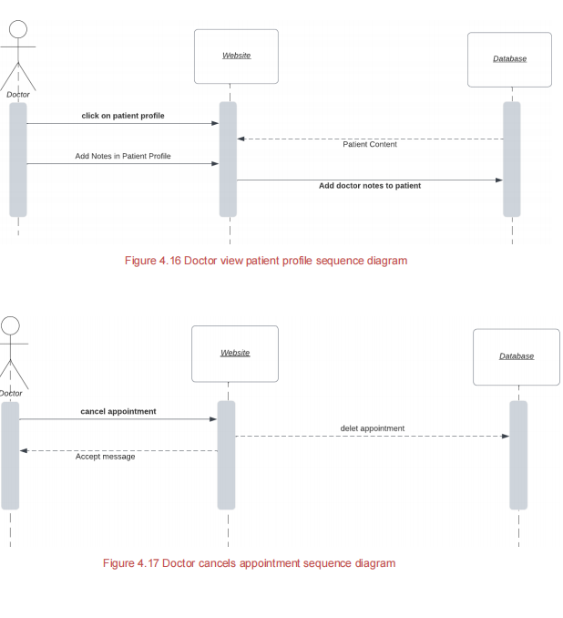
Sequence Diagram

Slide 35
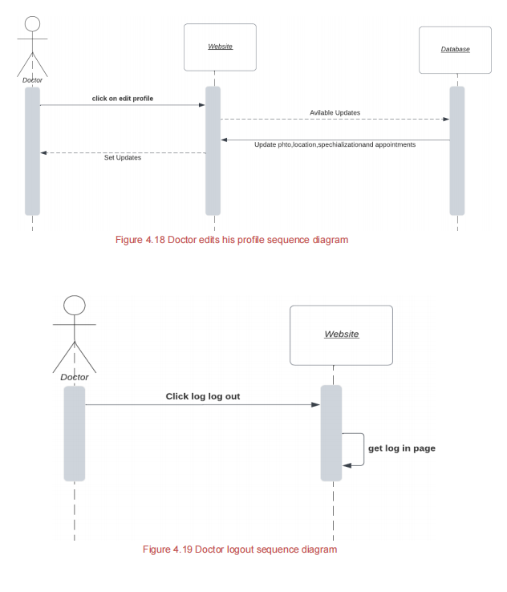
Sequence Diagram

Slide 36
Class diagram
A class diagram in the Unified Modeling Language (UML) is a type of static
structure diagram that describes the structure of a system by showing the
system's classes, attributes, operations (or methods), and relationships among
objects.

Slide 37
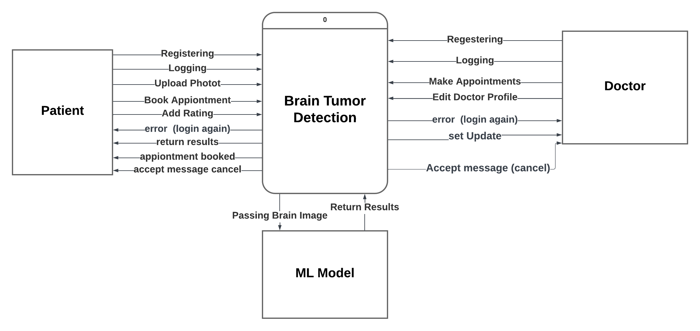
Context Diagram
The Context Diagram shows the system under consideration as
a single high-level process and then shows the relationship that
the system has with other external entities.

Slide 38
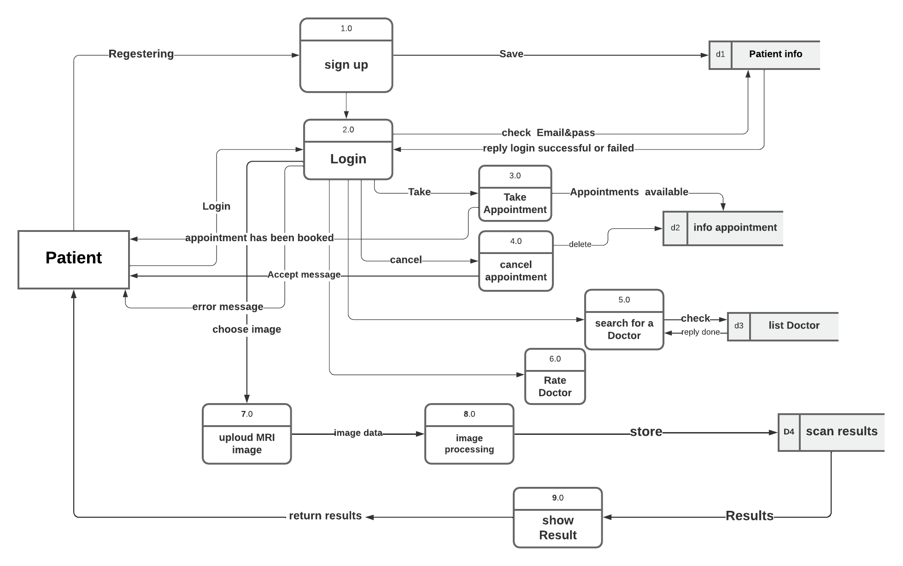
Data Flow Diagram
A data flow diagram (DFD) maps out the flow of information for any process or system.
DFD for Patient

Slide 39
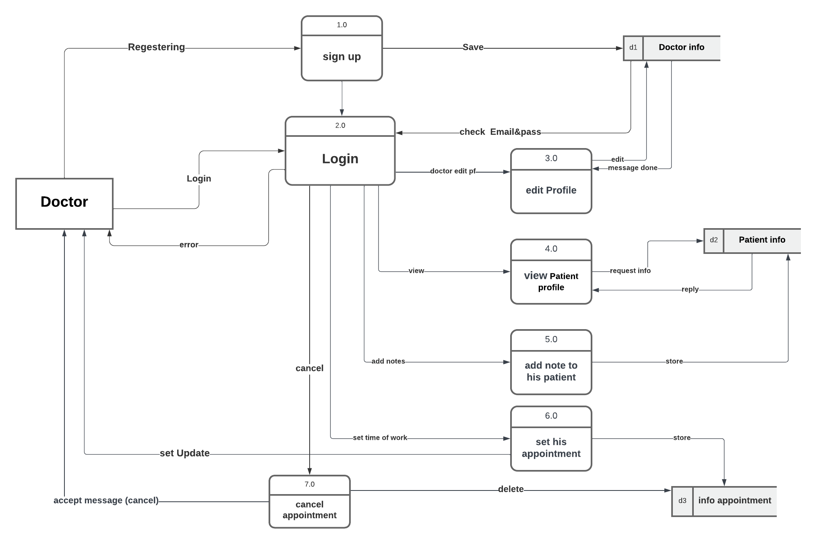
Data Flow Diagram
DFD for Doctor

Slide 40
Web Development
When the user opens the site, this is the first screen shown to him, and he cannot use any service within the site except by logging in.

Slide 41
Web Development
If the user pressed any of these buttons (choose a doctor – scan now) on the pre-log-in page, it will lead him to the log-in page if he does not have an account he can sign up for an account as a patient or doctor.

Slide 42
Web Development
The About Brain Tumors, tab shows some information about brain tumors

Slide 43
Web development
The services tab enables users to scan their MRI brain images by browsing the image from their local files and pressing scan then they get the result of their MRI scan, also services tab shows recommended doctors to take an appointment

Slide 44
Web development
Scan result appears to the user as a dialog on the same page.

Slide 45
Web development
The patient profile shows patient info an MRI image of his brain, information, and notes of his physician

Slide 46
Web development
Doctor’s home screen provides services for the doctors who are registered to the site,
Doctors can manage their booked appointments they can confirm or decline the appointments requests, and they can see their upcoming appointments.

Slide 47
Web development
Doctors can edit their profiles and add their available appointments for patients

Slide 48
Web development
Doctors also can view profiles of their patients and see their medical history and they can add notes to them.
And here is our Figma Link For more :
https://www.figma.com/file/DNb5seQr4CMvXn3M8znhVU/Brain-Tumor-Detection-web?type=design&node-id=0-1&mode=design&t=kmdPbXPX9pWaA6OH-0

Slide 49
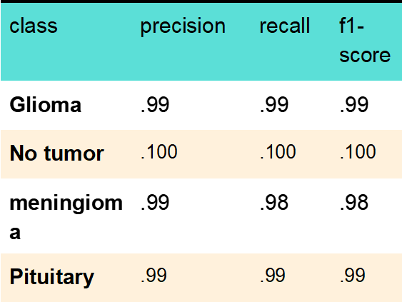
The Experimental Results & Discussion
the first scenario "brain tumor classification" obtained in 5738 images (80% train and 20% test).
log loss value of 0.03, which suggests that the model is performing very well in terms of predicting the probabilities of the classes.

Slide 50
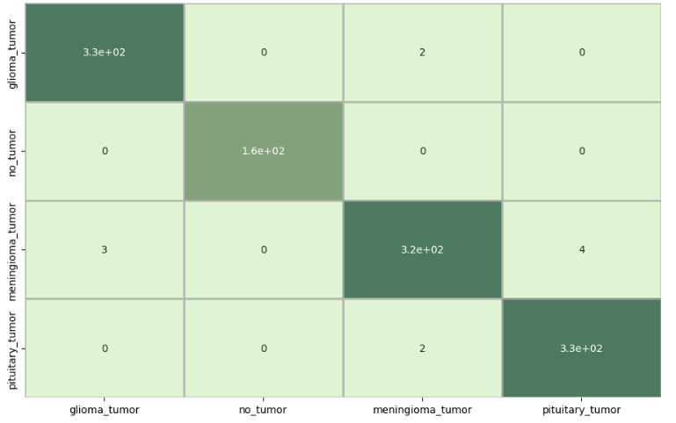
The confusion matrix
Figures provide a visual representation of the performance of the model.
show that the majority of the images were correctly classified, with only a small number of misclassifications.
02

Slide 51
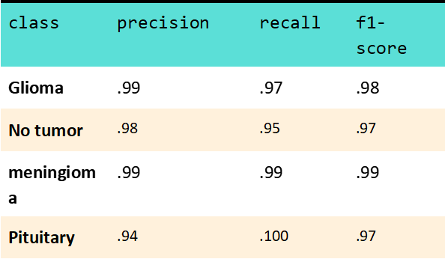
second scenario
the brain tumor classification model was trained and tested on 11450 images, with 80% used for training and 20% for testing. The model achieved an accuracy of 99.5%.

Slide 52
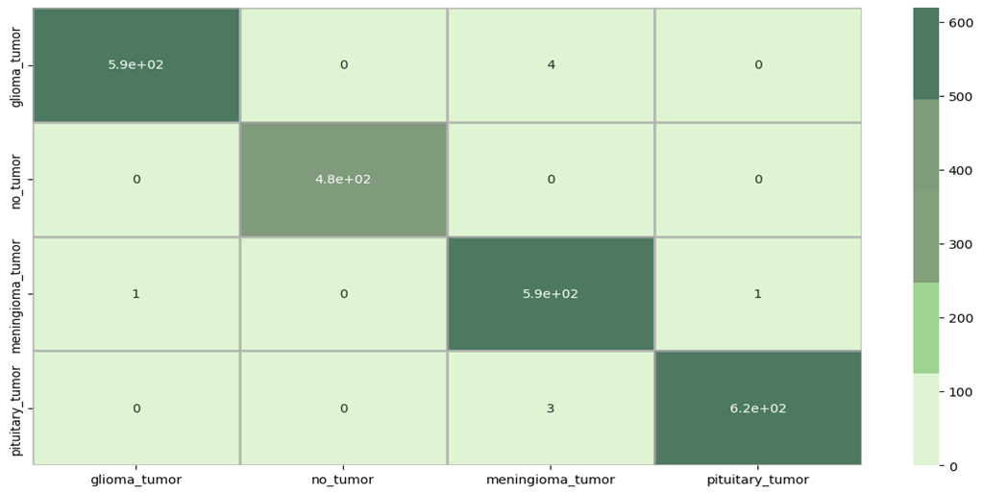
The confusion matrix
show that the majority of the images were correctly classified, with only a small number of misclassifications.
02

Slide 53
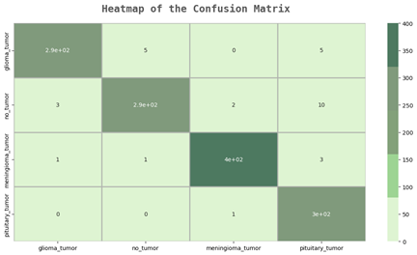
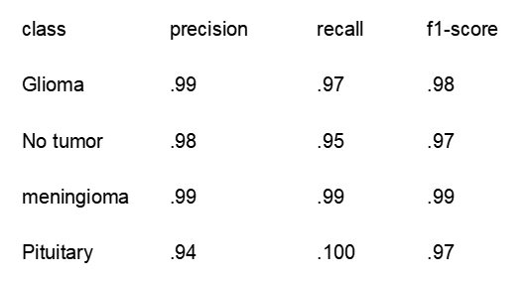
Test Data
The dataset consists of Four types of brain tumors: meningioma (306 slices), glioma (300 slices), pituitary (300 slices), and normal brain tissue (405slices).
The model was tested on a dataset containing 1311 brain tumor images and achieved an overall accuracy of 0.98. The precision, recall, and F1-score for each class were also provided

Slide 54

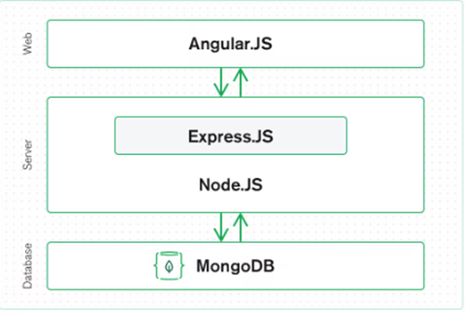
Used Technologies
The MEAN stack is a JavaScript-based framework for developing web applications. MEAN is named after Mongo DB, Express, Angular, and Node, the four key technologies that make up the layers of the stack. The MEAN architecture is designed to make building web applications in JavaScript and handling JSON incredibly easy.

Slide 55


Mean Stack Components
· Angular.js Front End
Angular.js allows you to extend your HTML tags with metadata to create dynamic, interactive web experiences much more powerfully than, say, building them yourself with static HTML and JavaScript (or jQuery).
· Express.js and Node.js Server Tier
has powerful models for URL routing (matching an incoming URL with a server function) and handling HTTP requests and responses. By making XML HTTP requests (XHRs), GETs, or POSTs from Angular.js front end, that can connect to Express.js functions that power the application. Those functions in turn

Slide 56

use MongoDB’s Node.js drivers, either via callbacks or using Promises, to access and update data in the Mongo DB database.
· Mongo DB Database Tier
Mongo DB comes in: JSON documents created in Angular.js front end can be sent to the Express.js server, where they can be processed and (assuming they’re valid) stored directly in Mongo DB for later retrieval.

Slide 57
Conclusions & Future Work
In conclusion, our graduation project introduces a groundbreaking website that utilizes advanced technology for early detection and diagnosis of brain tumors. Through the seamless process of uploading MRI images, our website provides rapid and accurate diagnoses. Additionally, it streamlines the appointment booking process with specialized doctors, enhancing the healthcare experience. Our project aims to improve patient outcomes and make a significant impact in the fight against brain tumors.

Slide 58
Future Work
Ethical and Legal Considerations
Performance and Scalability
Data Availability
Algorithm Development and Validation
Integration with Medical Systems

Slide 59
Thank you

